Slide 1
Automated Legal Judgment Processing using Deep Learning
Guided by,
Dr. Sivaranjani N (53900)
SCOPE
VIT CHENNAI
Presented by,
Nuka Nandan Vignesh (21BRS1473),
Narra Sathwik Reddy (21BRS1548)
SCOPE VIT CHENNAI

Slide 2
OUTLINE
Introduction
Problem Statement
Research Objectives
Research Challenges
Proposed System
System Diagram
Implementation & Results
Guide Approval Screenshot
References
Remaining Work

Slide 3
I. INTRODUCTION
Overview: Legal judgment documents contain critical information but are often lengthy and complex, making manual analysis time-consuming and inefficient. These documents typically include:
Case Facts: Detailed descriptions of events and parties involved.
Legal Arguments: The positions taken by each party, supported by legal reasoning.
Precedents: References to previous cases that inform or support arguments.
Final Rulings: The court’s decision and rationale behind it, including sentencing or injunctions.
Importance: Automating the extraction and processing of legal judgments can significantly improve accessibility, reduce workload, and enhance decision-making efficiency, bringing numerous benefits to various stakeholders:
Legal Practitioners: Lawyers can quickly access key case details, improving the speed and accuracy of analysis. This saves time for strategic planning, client interaction, and legal drafting.
Researchers: Automated systems help researchers quickly sift through case law to identify trends and contradictions, speeding up literature reviews and case studies.
Accessibility: Legal information becomes more accessible, increasing transparency and trust in the legal system.
Consistency and Error Reduction: Automated systems reduce human error, ensuring consistent and accurate legal analysis.

Slide 4
Challenges:
Extracting only the relevant judgment text while filtering out unnecessary legal jargon and formatting issues.
Handling variations in court document structures and ensuring high accuracy in information extraction.
Converting extracted text into audio while preserving legal semantics for better accessibility.
Ensuring high-accuracy speech-to-text conversion for legal language.
Objective: This project aims to develop an automated system that:
Extracts judgment text from legal PDFs using NLP and deep learning models.
Cleans and preprocesses the extracted text to improve readability.
Converts the text into high-quality speech using TTS models.
Applies audio processing techniques like VAD and normalization.
Uses Whisper to transcribe the audio back into text.
Evaluates performance through comparative analysis between extracted and transcribed text.

Slide 5
II. PROBLEM STATEMENT
Extracting meaningful judgment text from legal PDFs:
Legal judgments are often in PDF format, which can be difficult to work with due to how the text is embedded. Extracting key information, such as case facts, legal arguments, and rulings, requires advanced tools to pull out only the relevant content. This makes it easier for legal professionals to focus on important details without sorting through unnecessary information.
Converting extracted text into high-quality audio format:
Once the relevant text is extracted, converting it into high-quality FLAC audio format makes the information more accessible. FLAC (Free Lossless Audio Codec) preserves the clarity and quality of the original audio, ensuring accurate pronunciation of legal terms.
Enhancing Speech-to-Text transcription accuracy for legal documents:
Speech-to-text technology is key for converting spoken legal information into text, but standard systems may struggle with legal jargon. Improving transcription accuracy ensures the text reflects the correct legal terms and intent, preserving the integrity of case details.
Evaluating and comparing extracted vs. transcribed text for performance analysis:
To assess system effectiveness, it's important to compare extracted text from legal documents with transcribed speech-to-text output. This helps identify areas for improvement, ensuring accuracy, consistency, and clarity, and fine-tunes the system for future use.

Slide 6
III. RESEARCH OBJECTIVES
Develop an automated system for extracting judgment text from legal PDFs:
Create an automated system to extract key information such as case facts, legal arguments, and final judgements directly from legal PDFs.
The focus will be on accurately identifying and extracting relevant text, ignoring non-essential content.
Convert text into speech using advanced TTS models (Google Text-to-Speech):
Use Google’s advanced Text-to-Speech (TTS) model to convert the extracted text into high-quality speech (.flac). The TTS model will ensure accurate pronunciation, especially for legal terms, making it easy to listen to the judgments.
Implement audio preprocessing (VAD, normalization) to refine the output:
Apply Voice Activity Detection (VAD) to identify and extract only the speech parts, removing any background noise.
Use Whisper for Speech-to-Text conversion and assess its accuracy:
Employ the Whisper model to convert the speech back into text.
Compare and evaluate extracted vs. transcribed text using performance metrics:
Compare the accuracy and completeness of the extracted text from legal PDFs with the transcribed text produced by Whisper. Metrics like Word Error Rate (WER), Character Error Rate (CER), and BLEU (Bilingual Evaluation Understudy) score will be used to evaluate performance and identify areas for improvement.

Slide 7
IV. RESEARCH CHALLENGES
Preprocessing Complexity: Efficiently converting raw audio data into a usable format involves multiple preprocessing steps, such as normalization, resampling, and feature extraction. Ensuring the accuracy and speed of these processes is a major challenge, especially for large datasets like LibriSpeech.
Handling Diverse Accents and Noisy Environments: Speech-to-text models often struggle with varying accents, dialects, and noisy conditions. Developing a model that can generalize across these scenarios without significant performance degradation is a critical challenge.
Real-Time Performance: Achieving low-latency transcription while maintaining high accuracy is essential for live applications. This requires optimizing both the model architecture and the inference pipeline for real-time use.
Evaluation Metrics: Accurately measuring model performance involves metrics like Character Error Rate (CER), Word Error Rate (WER), and BLEU Score. Ensuring that these metrics are comprehensive and reflect real-world usability is a non-trivial task.
Model Adaptability: Creating a system that can adapt to various languages, accents, and contexts requires extensive training and fine-tuning. Ensuring scalability while maintaining performance across diverse use cases is a significant hurdle.

Slide 8
V. PROPOSED SYSTEM
System Overview:
The proposed system is designed to automate the extraction, processing, and analysis of legal judgment documents.
Key technologies used:
BERT for judgment text extraction
BERT (Bidirectional Encoder Representations from Transformers) is used for extracting meaningful judgment text.
Fine-tuning BERT on a specific legal dataset can further improve its ability to extract relevant details and ignore irrelevant content, making it more suited for the legal domain.
gTTS for text-to-speech conversion
Converts text into natural-sounding speech.
Whisper for speech-to-text conversion
High-accuracy transcription of legal audio, even with background noise.
Supports multiple languages and handles complex terminology.
TextBlob for grammatical corrections
Automatically corrects grammar and spelling mistakes.
Improves clarity and readability of legal text.

Slide 9
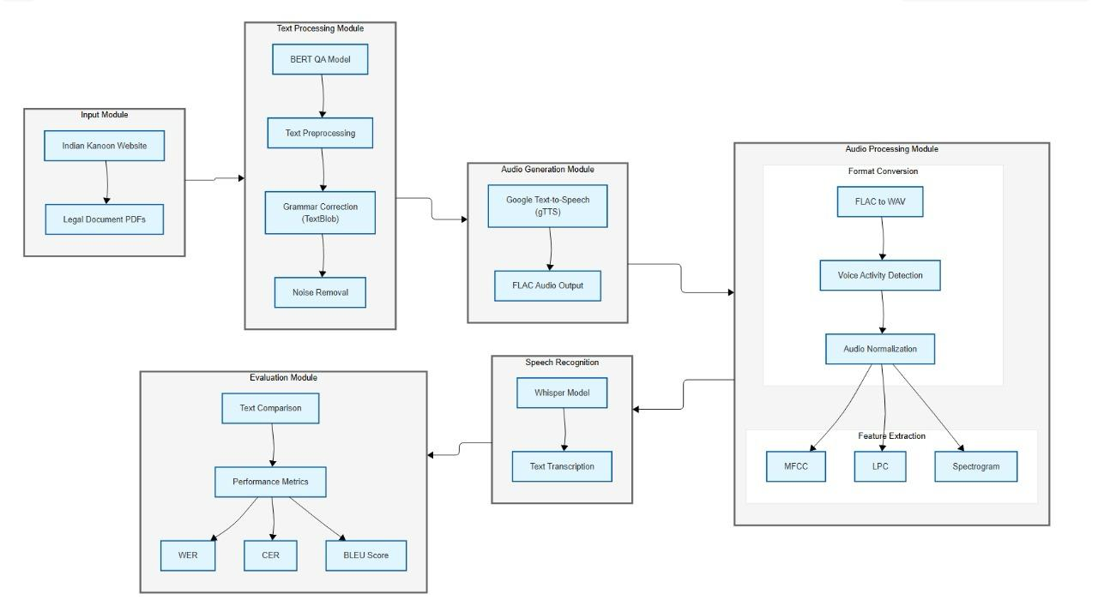
VI. SYSTEM DIAGRAM

Slide 10
Input Module: The system takes input from two sources:
Indian Kanoon Website – A legal database providing court judgments.
Legal Document PDFs – Directly uploaded PDF files containing court judgments.
Text Processing Module
BERT QA Model: Extracts relevant judgment text while removing unnecessary legal jargon.
Text Preprocessing: Cleans the extracted text by removing unwanted symbols, extra spaces, and formatting issues.
Grammar Correction (TextBlob): Enhances text readability by correcting grammatical errors.
Noise Removal: Eliminates irrelevant information such as references, citations, and case numbers that do not contribute to the judgment content.
Audio Generation Module
Google Text-to-Speech (gTTS): Converts the processed text into speech.
FLAC Audio Output: The generated audio is saved in FLAC format for better quality and compatibility with speech processing models.
Audio Processing Module
Format Conversion: Converts FLAC to WAV, as WAV is required for certain processing steps.
Voice Activity Detection (VAD): Detects and removes long silences from the audio.
Audio Normalization: Adjusts the audio levels to ensure consistent volume and clarity.
Feature Extraction: Extracts important features from audio for further analysis, including:
MFCC (Mel-Frequency Cepstral Coefficients): Represents audio features for speech recognition.
LPC (Linear Predictive Coding): Analyzes speech signals for phonetic modeling.
Spectrogram: Visualizes audio frequency distribution over time.

Slide 11
Speech Recognition Module
Whisper Model: Transcribes the processed audio back into text using OpenAI's Whisper speech-to-text model.
Text Transcription: The output is a machine-generated transcription of the original legal judgment.
Evaluation Module
Text Comparison: Compares the original extracted text with the transcribed text.
Performance Metrics: Measures transcription accuracy using:
Word Error Rate (WER): Measures the percentage of words incorrectly transcribed.
Character Error Rate (CER): Measures errors at the character level.
BLEU Score: Evaluates how closely the transcribed text matches the original text.

Slide 12
LIST OF MODULES
PDF Text Extraction Module
Uses pdfplumber to extract raw text from legal judgment PDFs.
Applies BERT to identify and extract only the judgment portion, eliminating irrelevant text.
Text Preprocessing & Cleaning Module
Removes unnecessary elements like URLs, case citations, and page numbers.
Fixes grammatical errors and improves readability using TextBlob.
Ensures consistent formatting for accurate speech conversion.
Text-to-Speech (TTS) Conversion Module
Converts the extracted judgment text into speech format (FLAC) using gTTS.
Ensures proper pronunciation and legal terminology preservation.
Audio Processing Module
Converts FLAC → WAV for compatibility.
Applies Voice Activity Detection (VAD) to remove silence and background noise.
Normalizes audio levels for clarity.

Slide 13
Speech-to-Text (STT) Module
Uses OpenAI's Whisper model for high-accuracy transcription.
Converts spoken audio back into text while preserving legal context.
Performance Evaluation & Comparison Module
Compares the original extracted text vs. transcribed text.
Calculates Character Error Rate (CER), Word Error Rate (WER), and BLEU scores.
Generates performance metrics for analysis.

Slide 14
VII. IMPLEMENTATION AND RESULTS
Open Google Colab and create a new notebook.
Mount Google Drive to access datasets and store results.
Install necessary Python packages like torch, torchaudio, librosa, transformers, and openai-whisper.
Load PDF or text files from Google Drive.
Perform text preprocessing:
Remove unwanted characters and newlines.
Apply grammar correction using TextBlob.
Remove noise from the text.
Use Google Text-to-Speech (gTTS) to generate speech from text.
Save the generated audio in FLAC format.
Convert FLAC to WAV format for compatibility.
Apply Voice Activity Detection (VAD) to remove silence.
Normalize the audio for uniform volume levels.
Extract features like MFCC, LPC, and Spectrogram for analysis.
Use OpenAI’s Whisper model to transcribe speech to text.
Compare transcribed text with original legal text.
Compute evaluation metrics: Word Error Rate (WER), Character Error Rate (CER) and BLEU Score

Slide 15
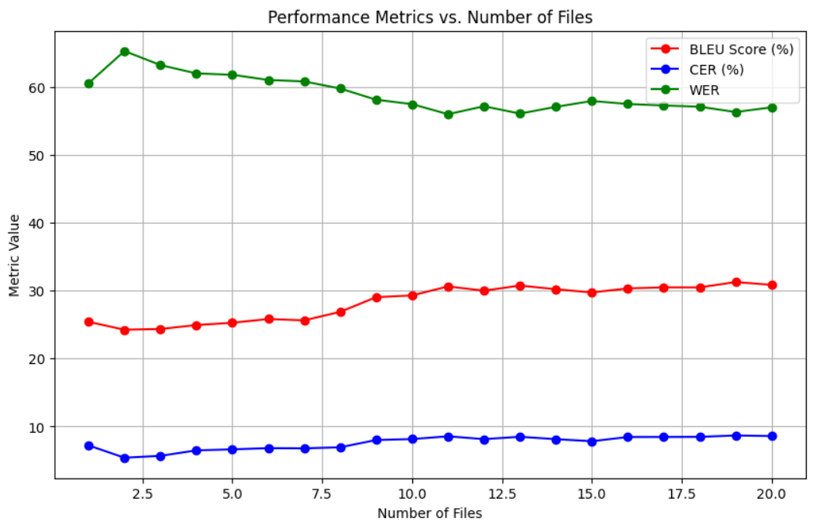

Slide 16
WER (Word Error Rate) Analysis:
The WER shows a steady decrease over time, from 30.86% at file 20 to 25.41% at file 1. This decline suggests that the transcription system is becoming more accurate as more files are processed, which is a positive trend. However, the rate of improvement is not very steep, indicating that while progress is being made, the transcription system may have reached a performance plateau after a certain point. The decrease is still significant enough to suggest that the system is gradually refining its ability to correctly transcribe words.
CER (Character Error Rate) Analysis:
Similar to WER, CER also shows a gradual decrease over the files, from 8.58% at file 20 to 7.21% at file 1. This steady improvement indicates that the transcription system is refining its character-level accuracy. As with WER, this slow but steady decline suggests that the model is learning to handle transcription at the character level with higher precision over time.
BLEU Score Analysis:
The BLEU score increases gradually from 57.01 at file 20 to 60.57 at file 1. Although the improvement in BLEU is modest, it shows a positive trend, which suggests that the model's ability to generate text that matches the reference improves as files are processed. The slow but steady increase in BLEU score indicates that while the model may not be drastically improving, there is a consistent gain in translation quality, possibly reflecting better alignment with the reference text.

Slide 17
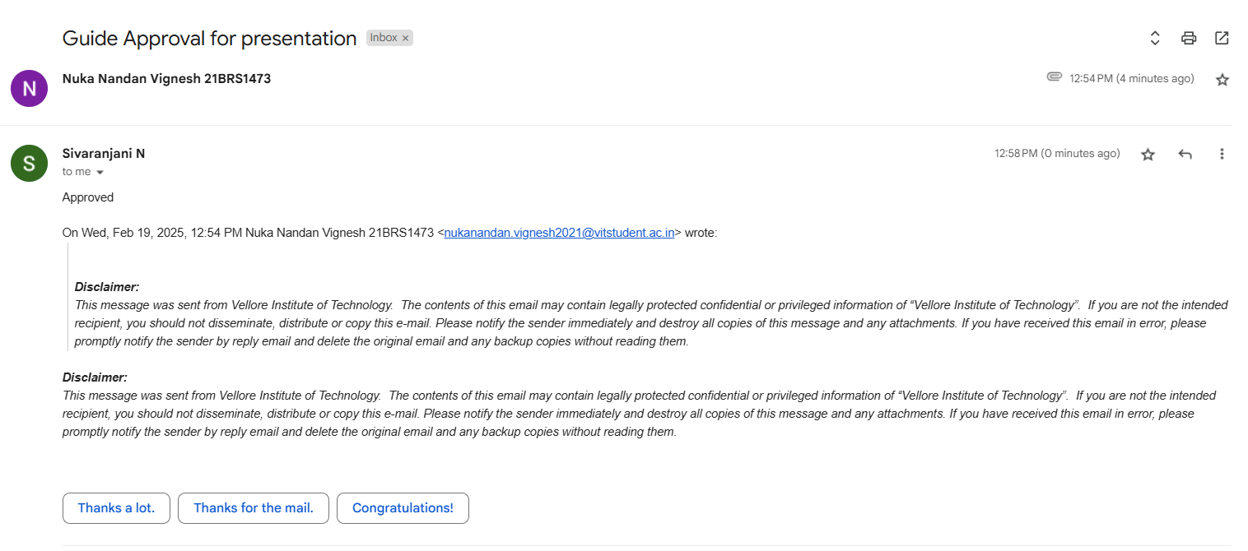
VIII. GUIDE APPROVAL SCREENSHOT

Slide 18
IX. REFERENCES
2Hannun A, Case C, Casper J, et al. Deep Speech: Scaling up end-to-end speech recognition. arXiv preprint arXiv:1412.5567. 2014. https://arxiv.org/abs/1412.5567.
Amodei D, Ananthanarayanan S, Anubhai R, et al. Deep Speech 2: End-to-End Speech Recognition in English and Mandarin. arXiv preprint arXiv:1512.02595. 2015. https://arxiv.org/abs/1512.02595.
Kanda N, Yoshioka T, Hori T, et al. Ensemble of Jointly Trained Deep Neural Network-Based Acoustic Models for Reverberant Speech Recognition. arXiv preprint arXiv:1608.04983. 2016. https://arxiv.org/abs/1608.04983.
Radford A, Kim JW, Hallacy C, et al. Robust Speech Recognition via Large-Scale Weak Supervision. OpenAI. 2022. https://arxiv.org/abs/2212.04356.
Chorowski J, Bahdanau D, Serdyuk D, et al. State-of-the-Art Speech Recognition with Sequence-to-Sequence Models. arXiv preprint arXiv:1609.08144. 2016. https://research.google.com/pubs/archive/46687.pdf.
Baevski A, Zhou Y, Mohamed A, Auli M. Wav2Vec 2.0: A Framework for Self-Supervised Learning of Speech Representations. Advances in Neural Information Processing Systems (NeurIPS). 2020. https://proceedings.neurips.cc/paper/2020/file/92d1e1eb1cd6f9fba3227870bb6d7f07-Paper.pdf.
Shilov N, Shchur L, Ponomarev D, et al. Automatic Speech Recognition (ASR) with Whisper. CEUR Workshop Proceedings. 2022. https://ceur-ws.org/Vol-3574/paper_1.pdf.

Slide 19
X. REMAINING WORK
Add more dataset and check the performance
Experiment with different models to identify the best performer.
Train the selected model on the processed dataset.
Assess the model’s performance using:
Character Error Rate (CER)
Word Error Rate (WER)
BLEU Score
Fine-tune the model if initial results are not satisfactory.
Deploy the model for real-time speech-to-text conversion.
Preparation of Research Paper
Work on simple web application for real time.

